Slide 1



Growing and Glowing
Marianne Madelaine V. Mencias

Slide 2
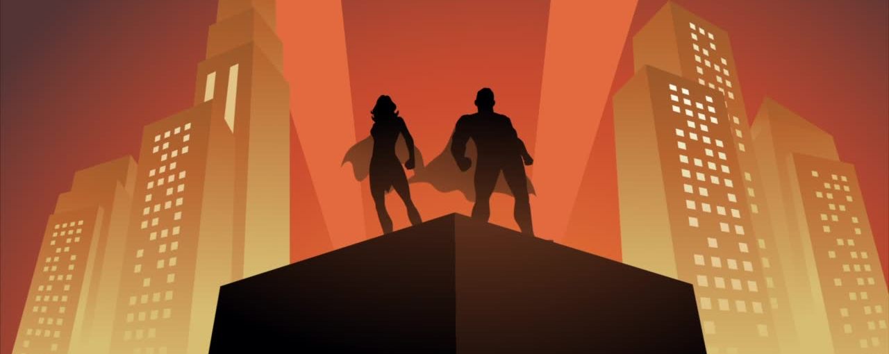
THANK YOU SUPERHEROES!

Slide 3

How much you grow and glow,
is how much the Philippines
will grow and glow!
Notes:
Whats a leader, naitonbuilding really starts with you

Slide 4
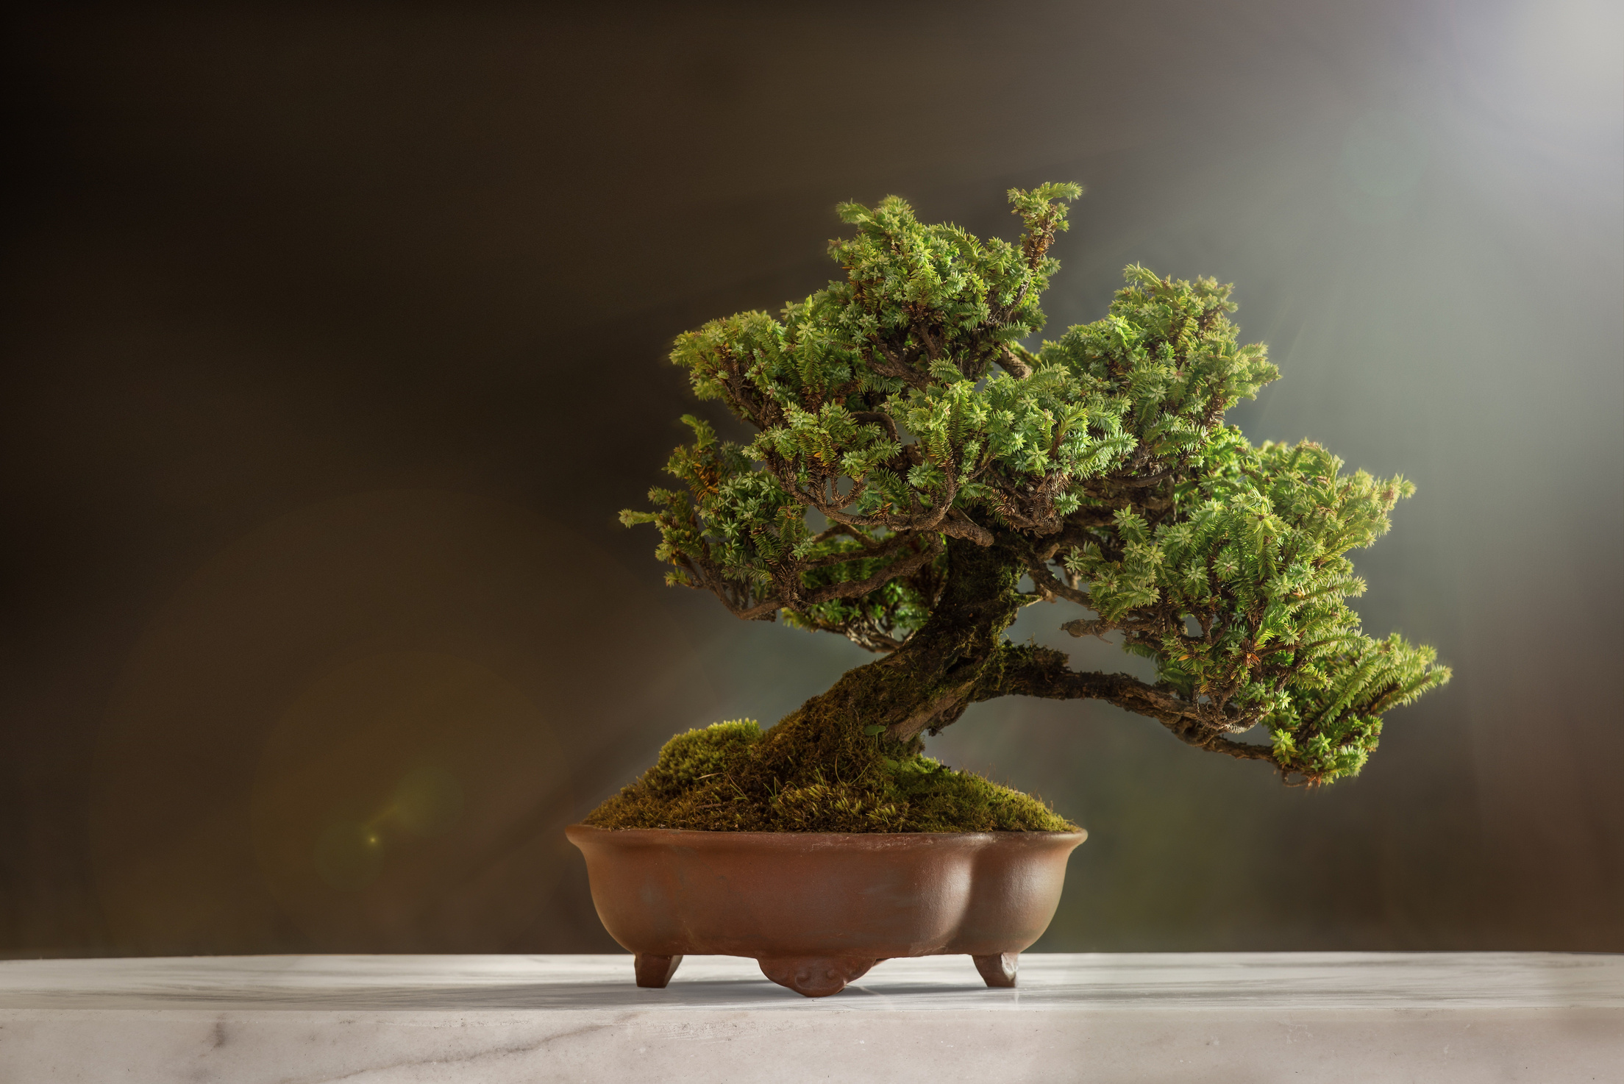
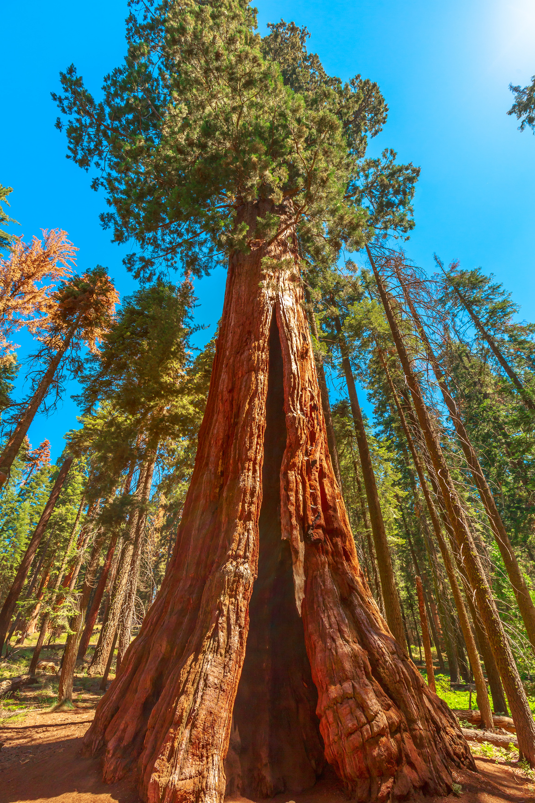
The choice is yours
BONSAI
or
SEQUIOA

Slide 5

The only time you are growing is when you’re uncomfortable.
Notes:
salmon

Slide 6



The truly productive don’t just play the game, they change the game.

Slide 7



3 ways to Grow and Glow
Self-care
1
Self-mastery
2
Service and Spirituality
3

Slide 8
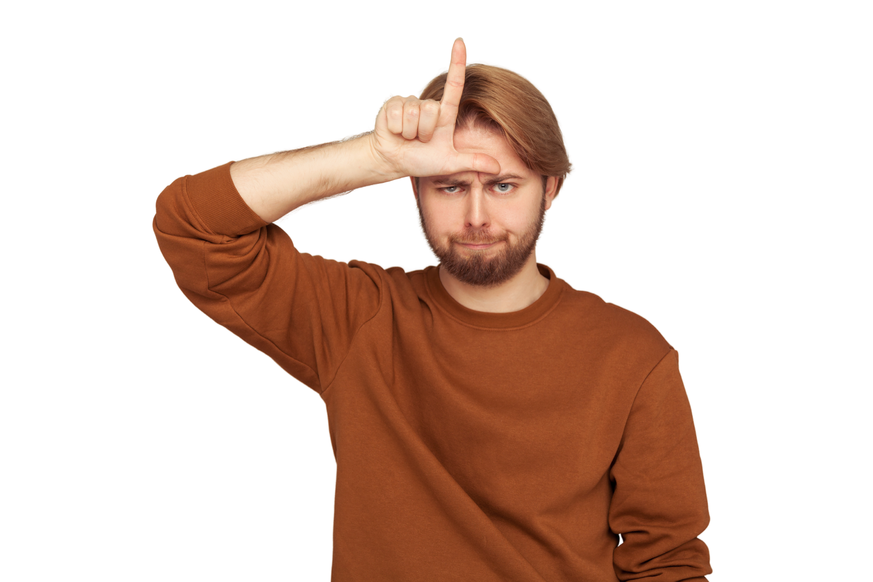

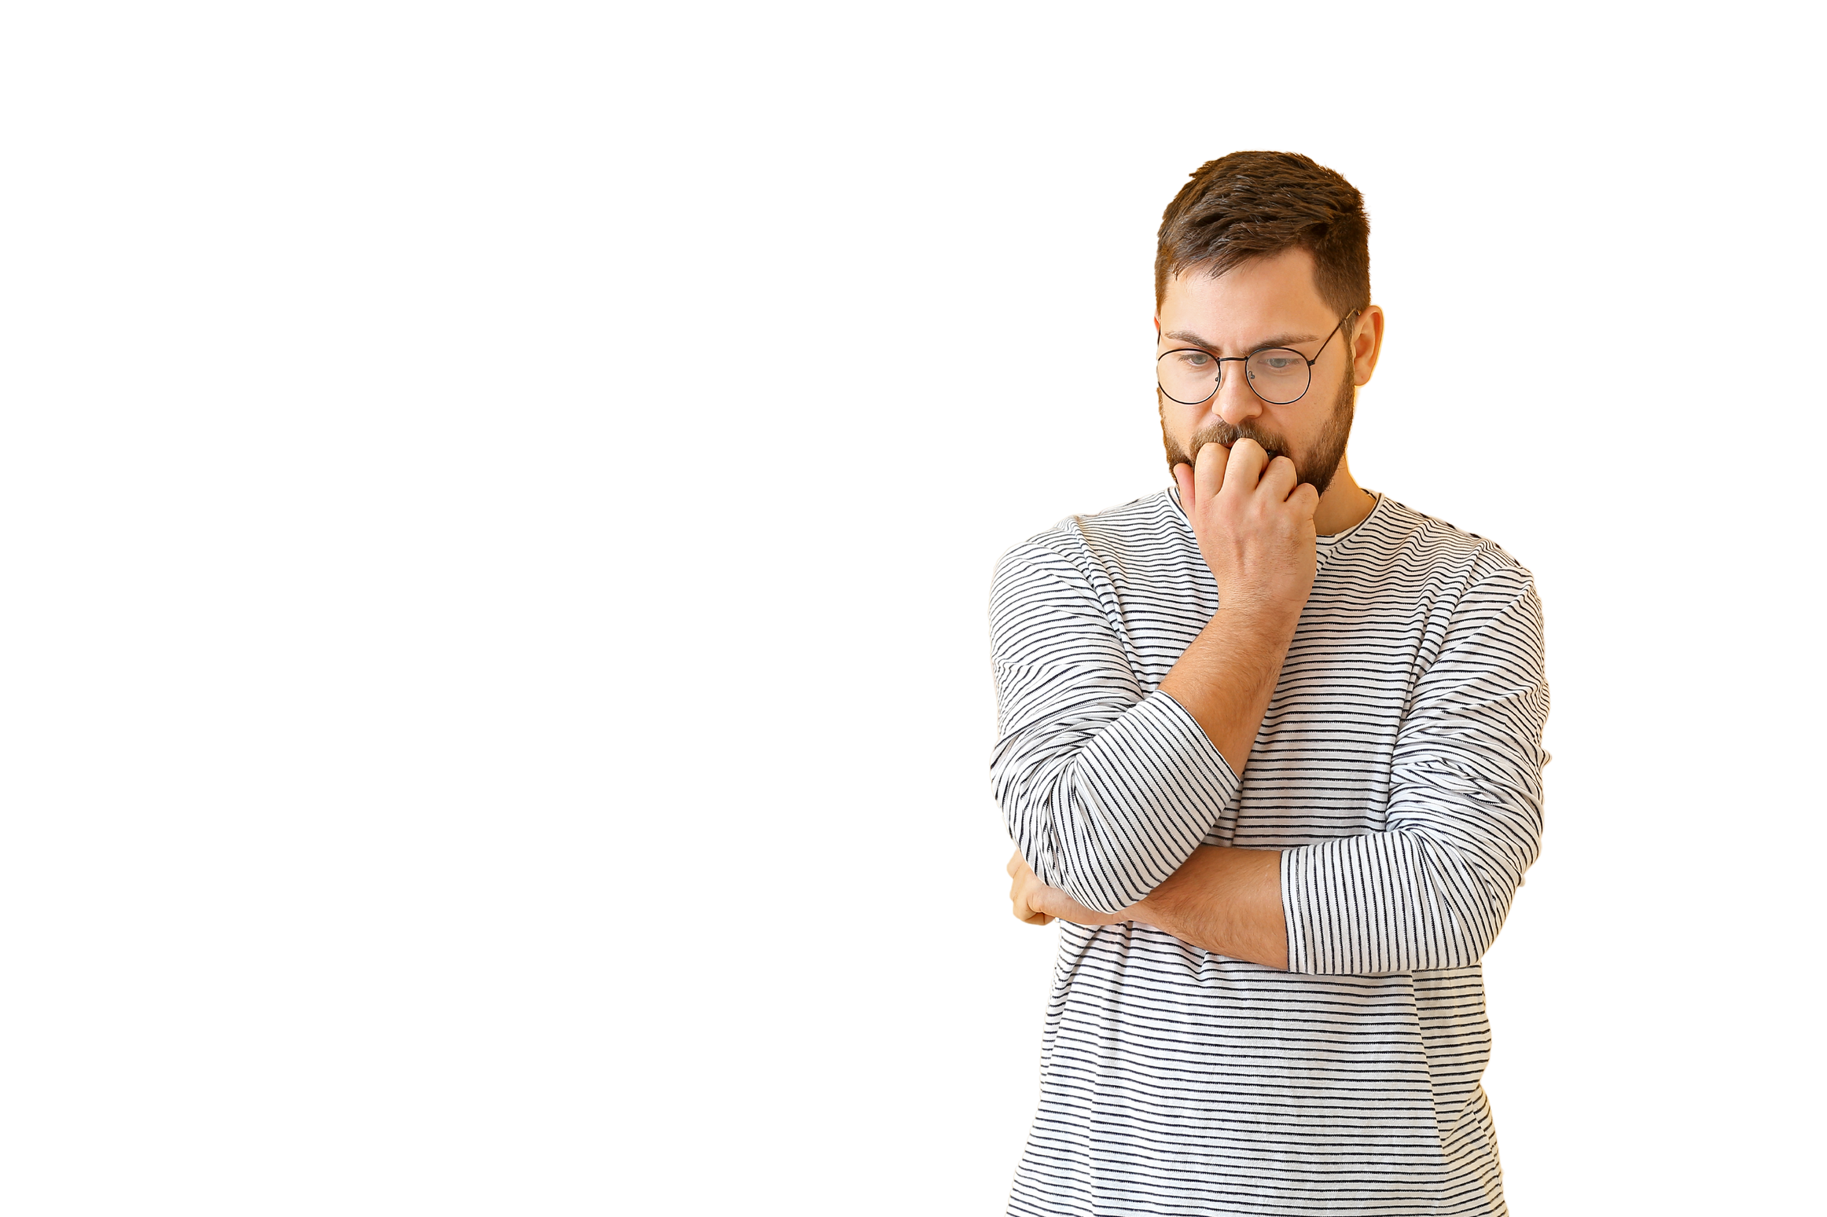
Self-care
1
What are your self-labels?
What messages do you tell yourself?
Loser
Hanggang dito nalang ako
Maritess

Slide 9
Most often than not, our labels come from our childhood and history with people.
“Hurt people, hurt people.”

Slide 10

SORRY
“It hurt. It mattered.
And I choose to release you.”
Be gentle and forgiving with yourself too!

Slide 11


“We are created in His image
and likeness.” (Genesis 1:27)
Our words have power!
They become reality!
Notes:
Deformed or reformed

Slide 12

Time to go back to the TRUTH!
First, tell me, what are the
characteristics of successful people?

Slide 13
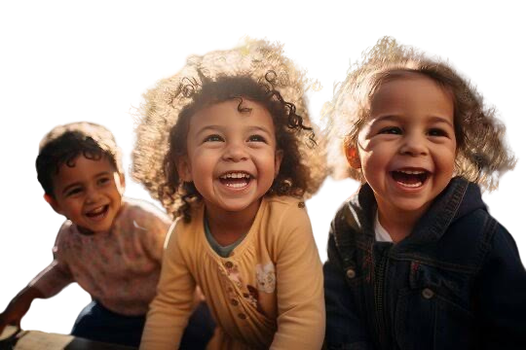
Look at little kids!

Slide 14
Everything you aspire to be,
you already are!

Slide 15
We have the power to change our thoughts until the day we die – backed up by studies in Neuroscience
“I am a Child of God.”
“I come from victory.”
“I am God’s Masterpiece.”

Slide 16

The devil will do everything to make you forget how wonderful you are.
God will always be there beside you to remind you and send you people who will! Let’s pray to be that kind of persons to others as well.

Slide 17


Write that
in a post it!
Choose 1 declaration and
SHOUT IT NOW!

Slide 18
Quick Game Tayo

Slide 19
But wait there’s more!
How else to care for yourself?

Slide 20
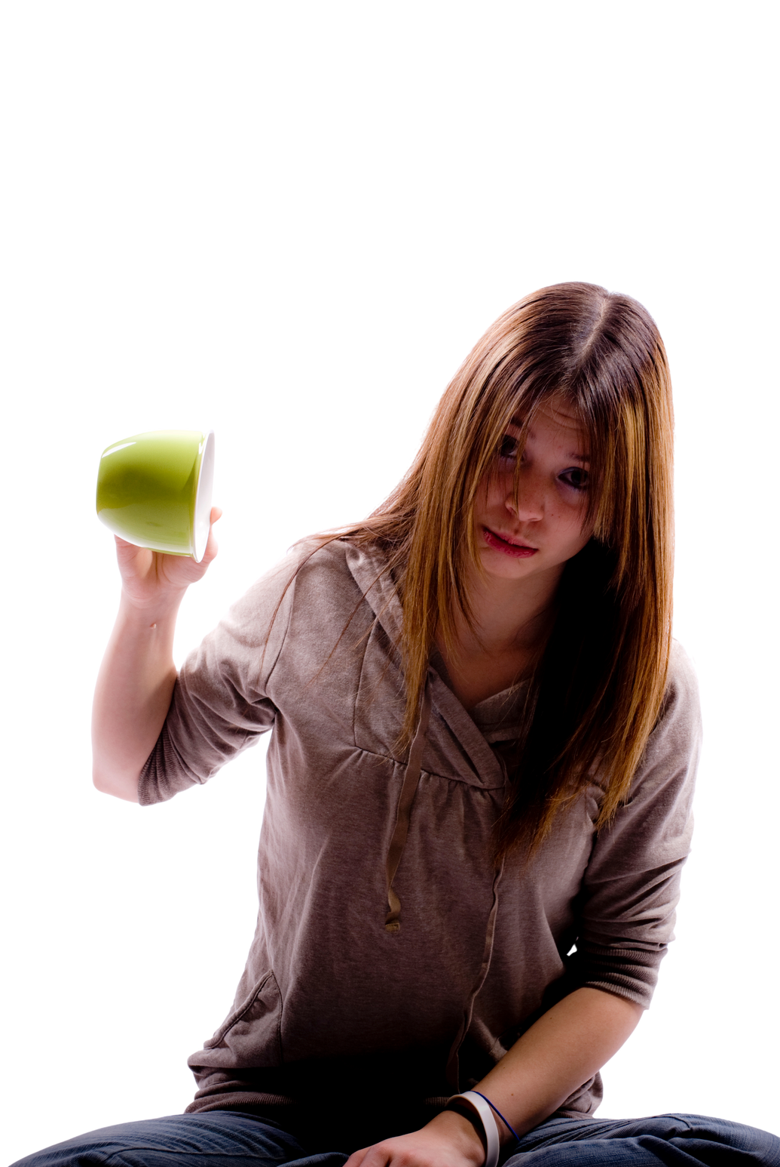

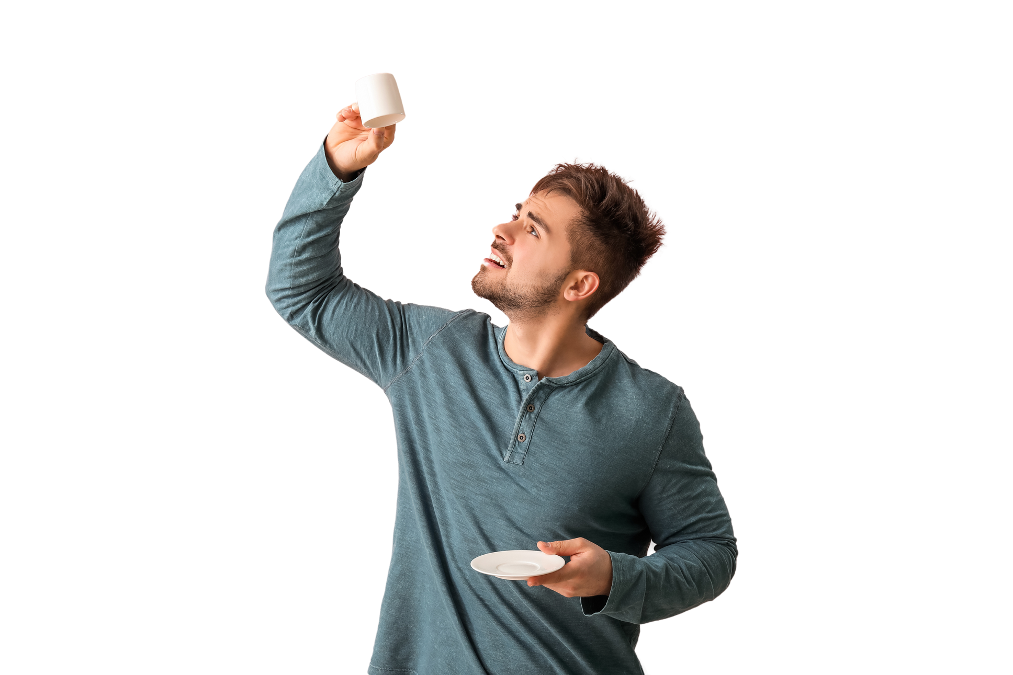
When the cup is empty,
how can you pour to others?
You can only give
what you have.

Slide 21

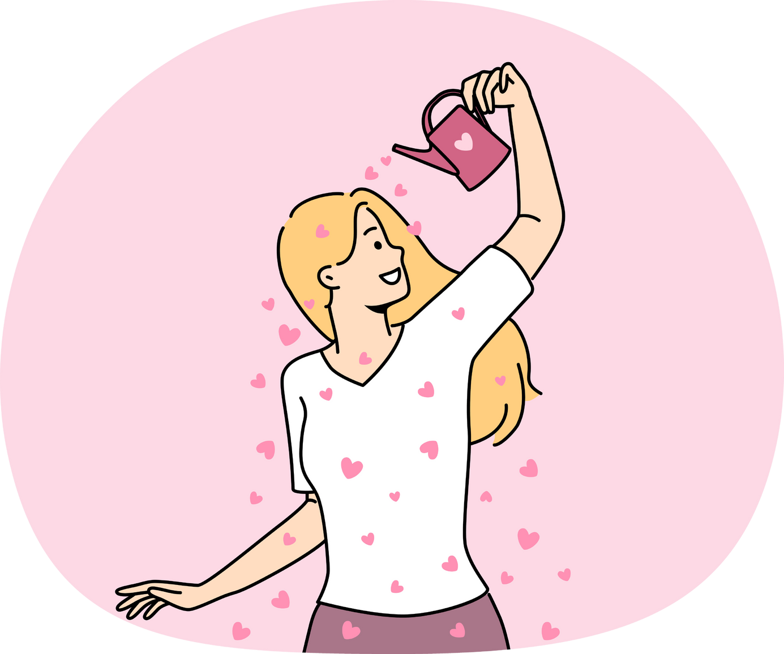

Pour in to Pour Out!

Slide 22
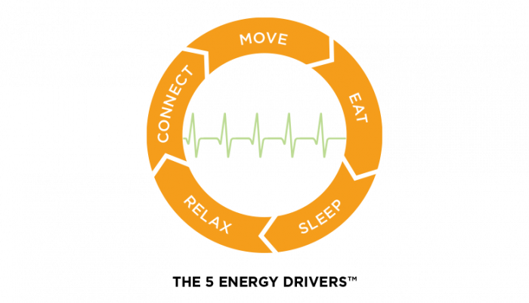

Slide 23
Rate yourself from 1-10:
Sleep:
Eat:
Move:
Rest, Relax and Play:
Connect:

Slide 24
The best bridge
between depression and
hope is a good night’s sleep.

Slide 25

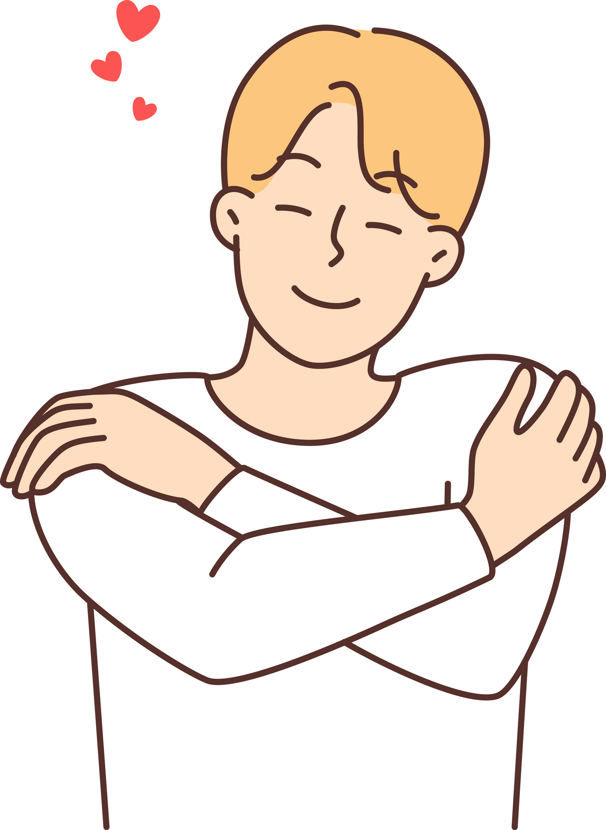
Take care of yourself so
you can continue to serve.

Slide 26

“My job is to be the
best version of myself,
so it is what
I can give to you.”

Slide 27




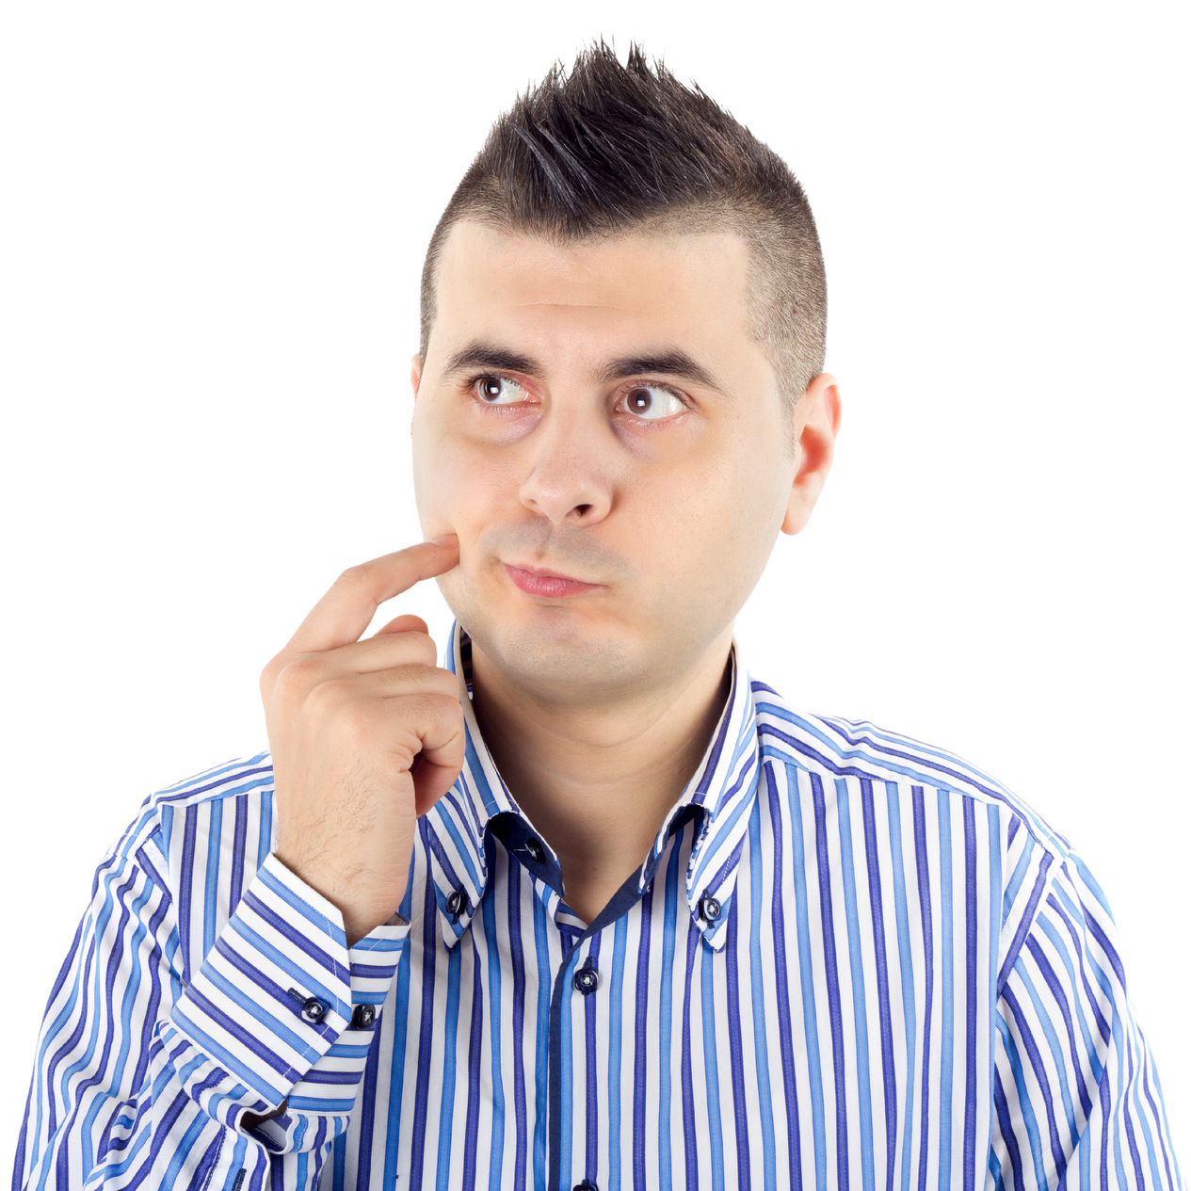
Self-mastery
2
Marupok ba you?

Slide 28
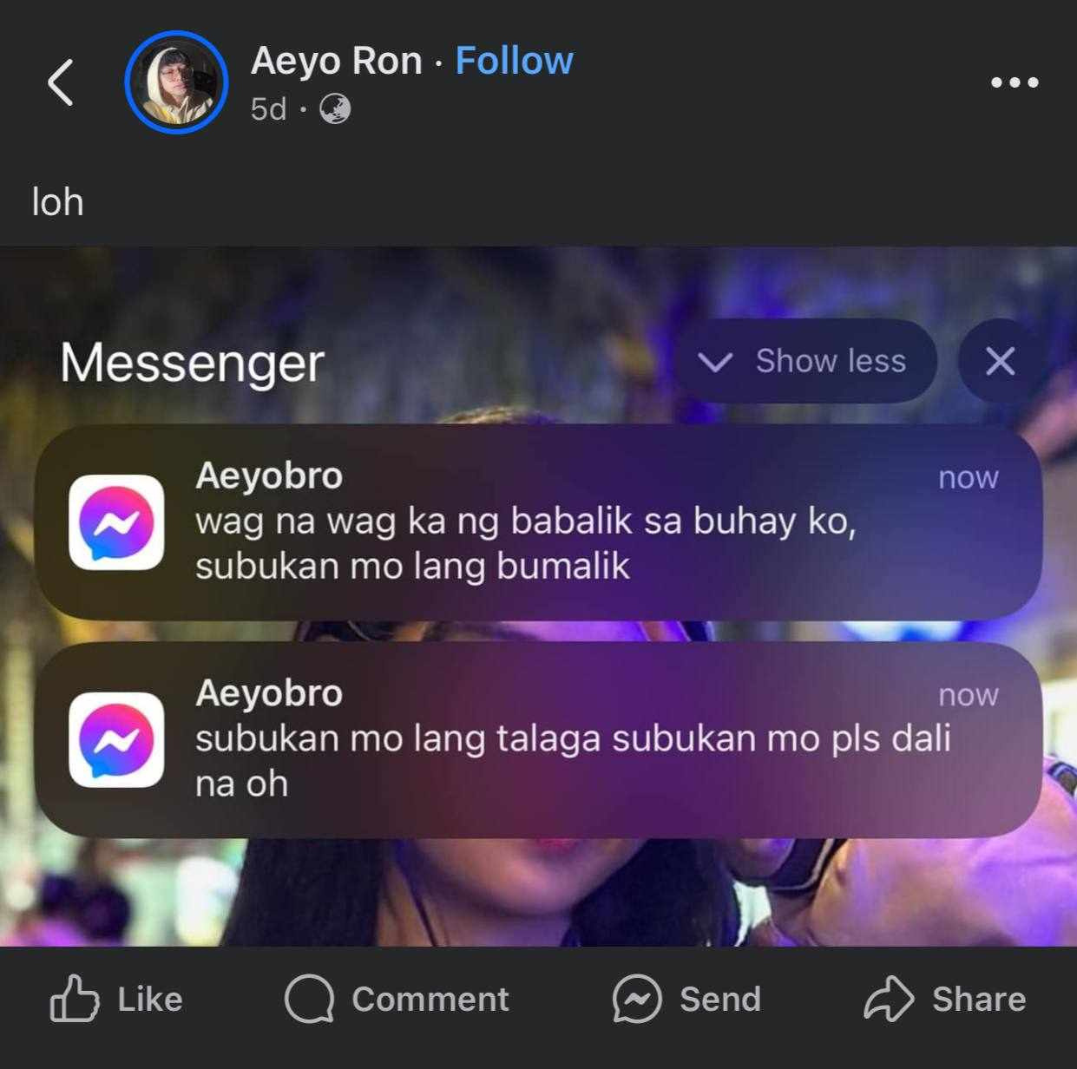
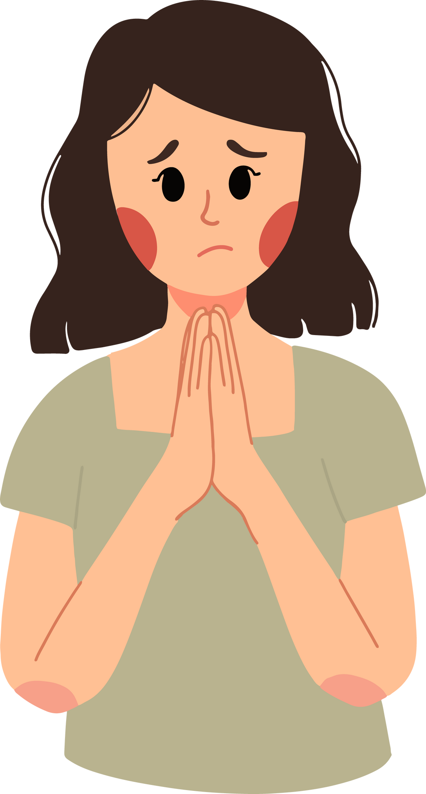
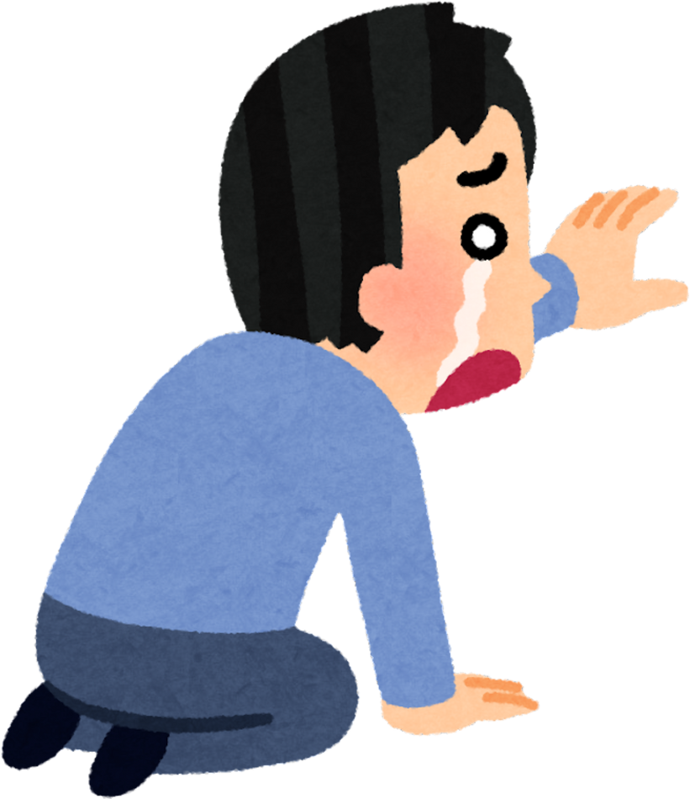

Slide 29
Observe yourself.
San ka ba marupok?
Pag-ibig?
Pera?
People pleasing?
Paggamit ng social media?

Slide 30

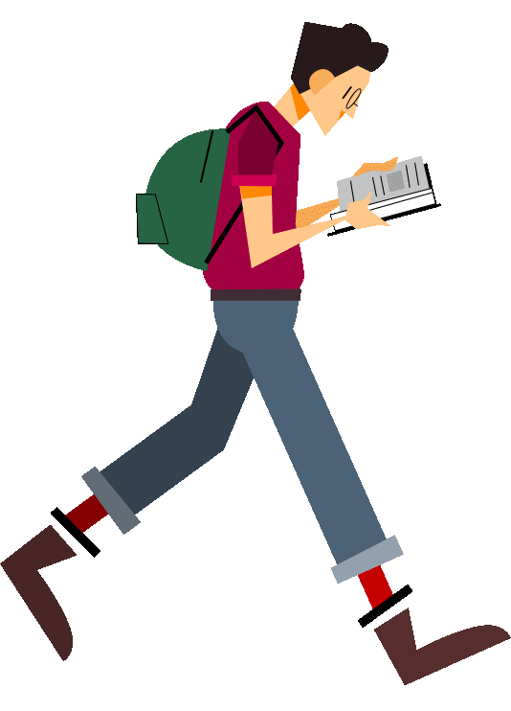
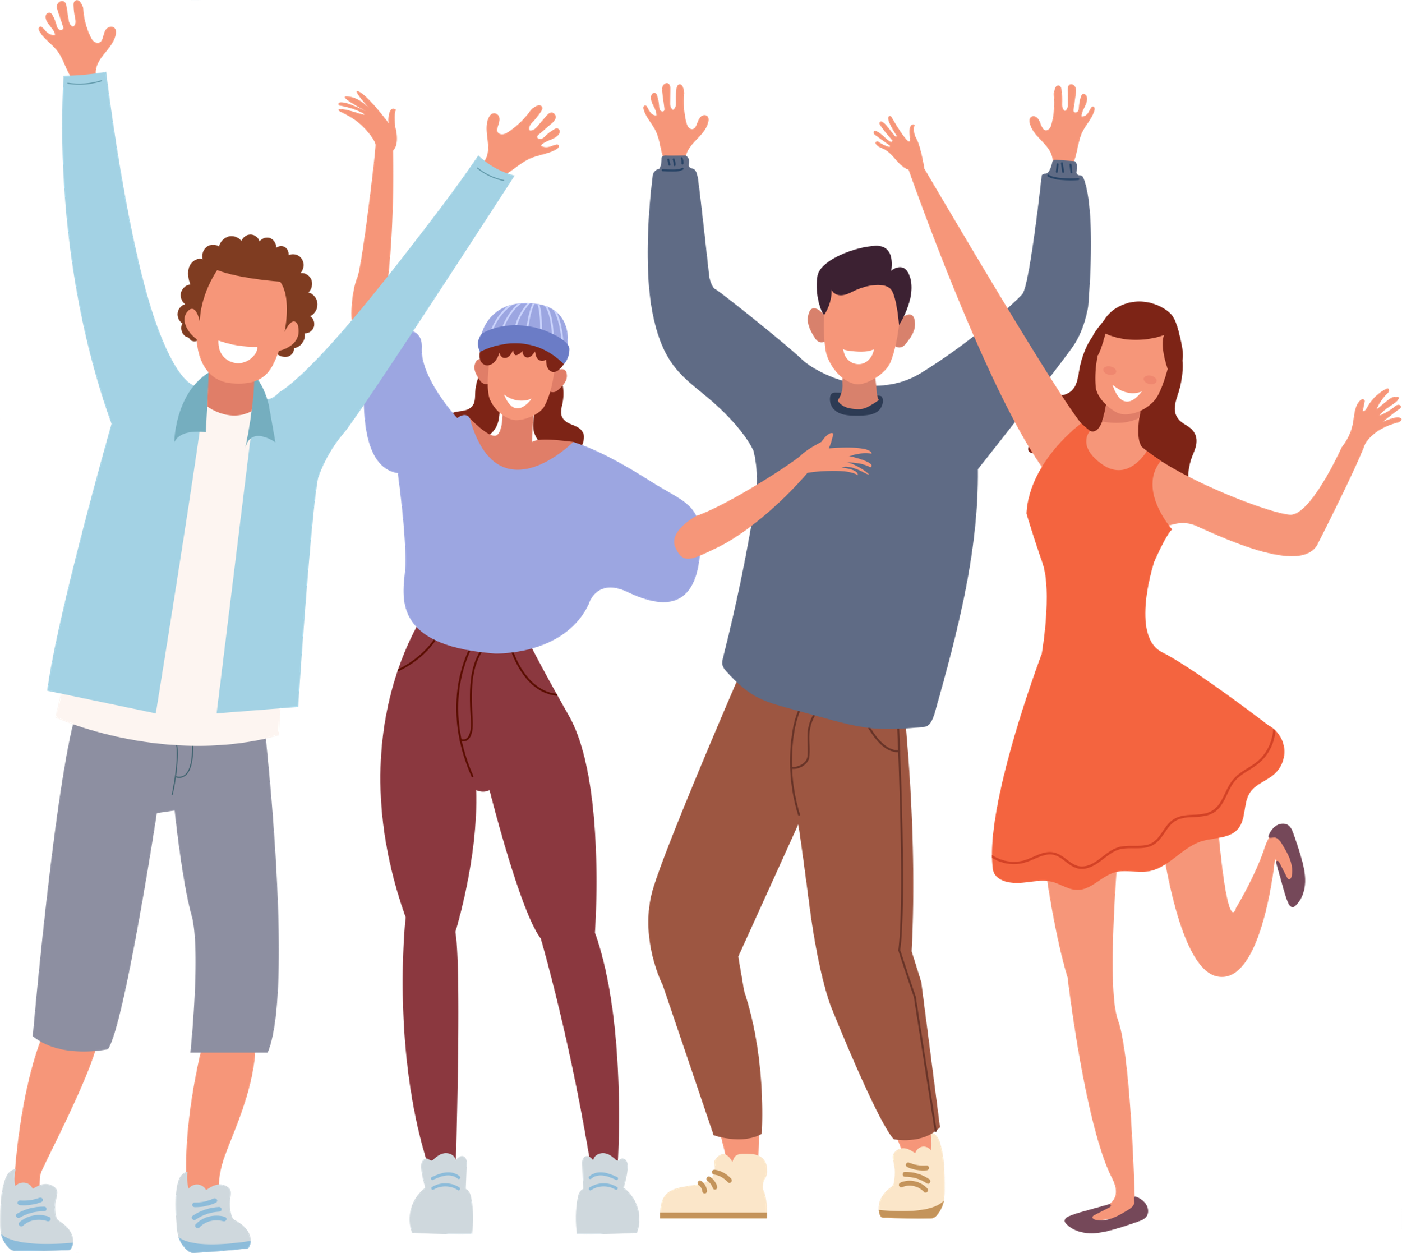
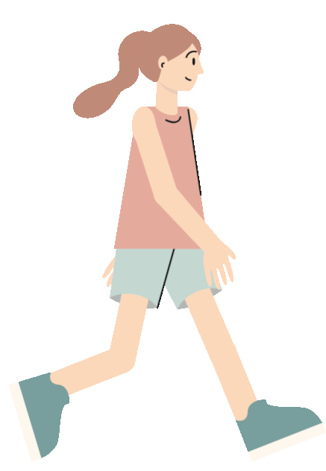

Gusto mo na ba makatawid?
Marupok
Marunong

Slide 31
Research shows that most emotions will rise up, then fall away, within 90 seconds, if you don’t react to them.

Slide 32
Respond vs. React

Slide 33

#GotoGodAgadAgad
Vertical before Horizontal

Slide 34

Karupokan: Ano sasabihin ng iba?
Let them; Let me
(Focusing on what you can’t control makes you stressed. Focusing on what you can control makes you powerful; TWA.)
Notes:
Study ordinances, learn from mentors , processes for agencies

Slide 35
“Change yourself.
Don’t worry about anybody else and the other changes will come.”

Slide 36

TO ACT IS TO MODIFY THE SHAPE OF THE WORLD.

Slide 37
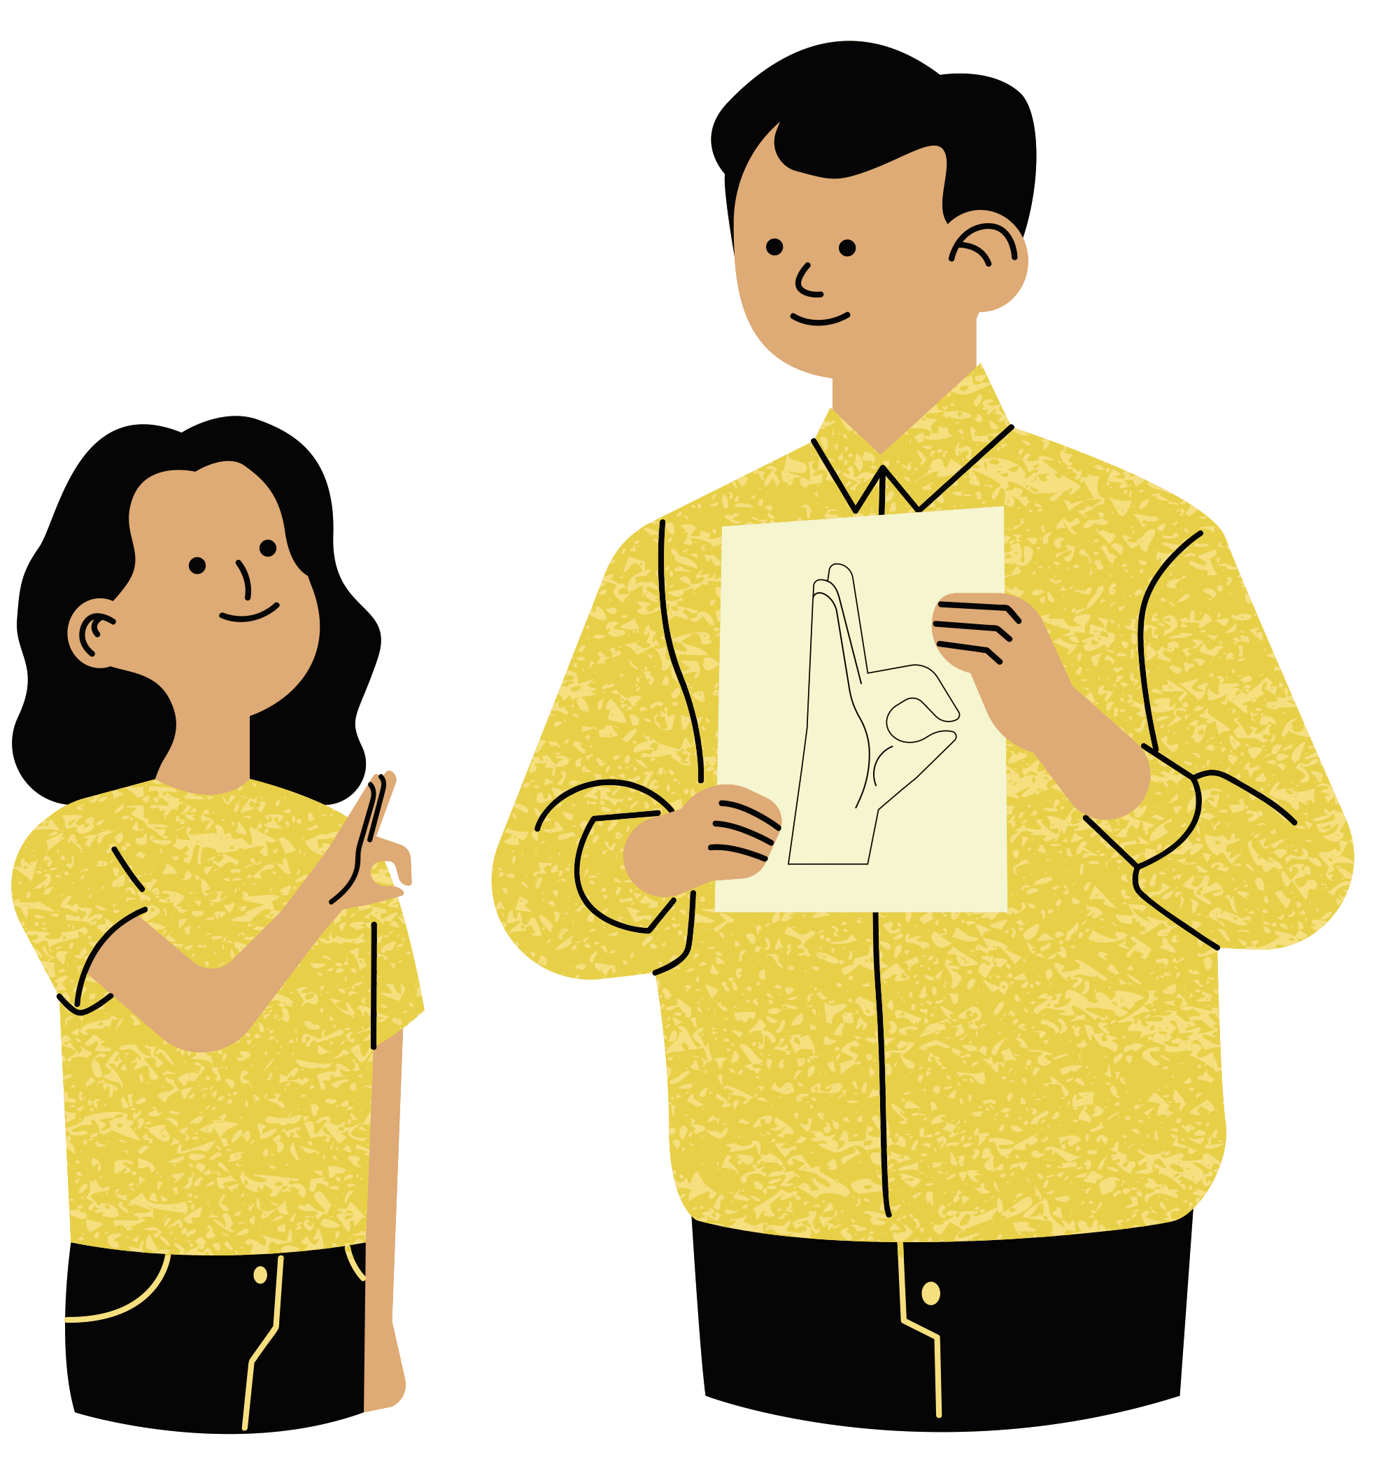
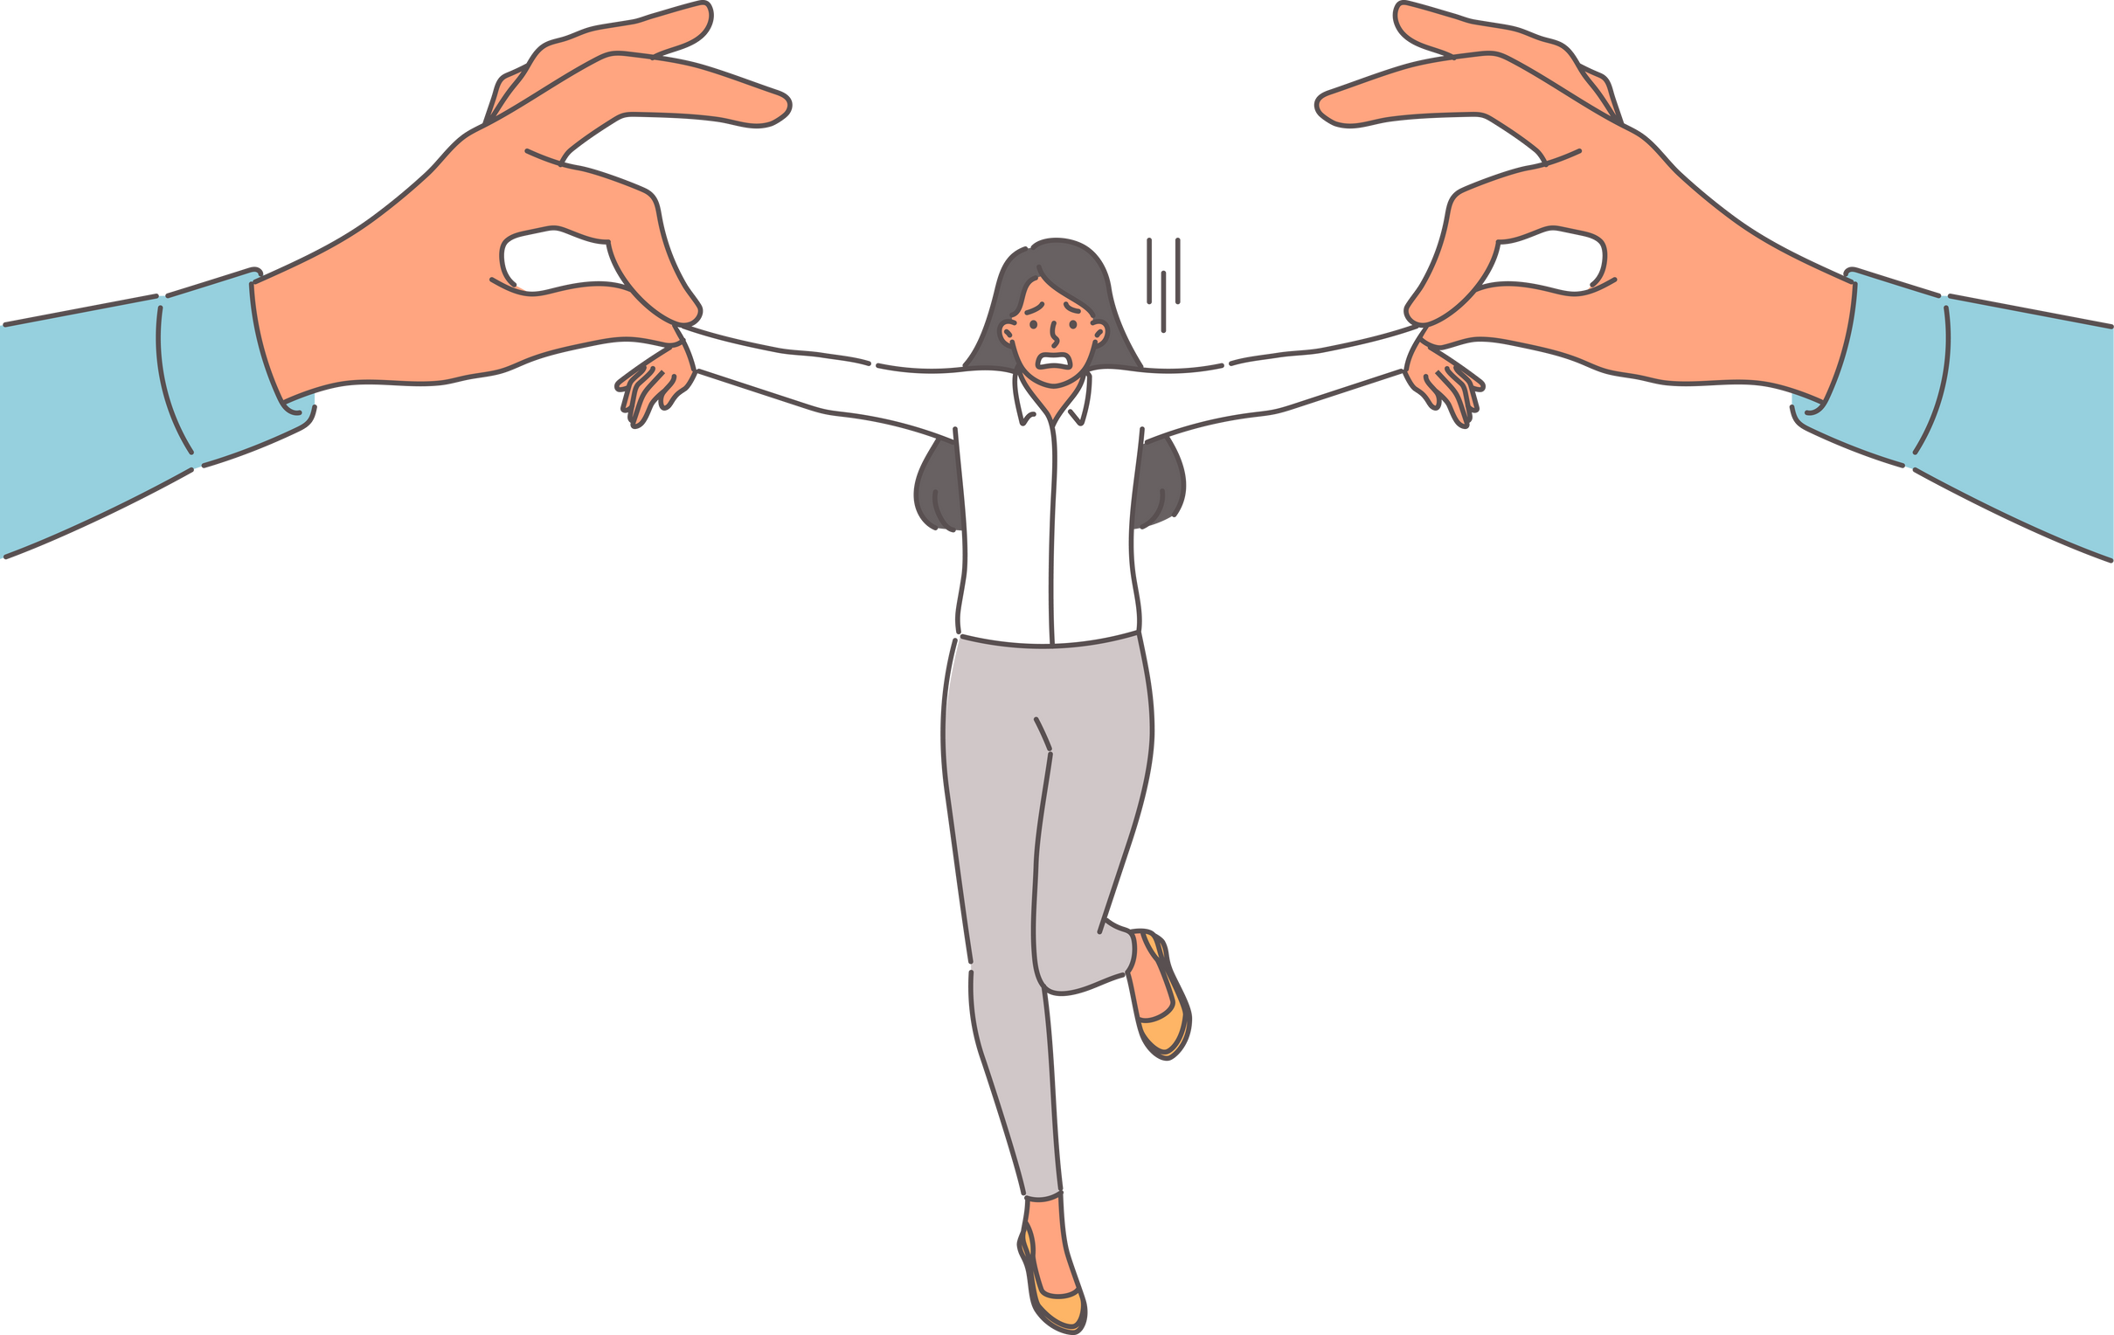
Karupokan: Comparison
Torture vs. Teacher

Slide 38

A MESSAGE FOR WOMEN
International Women’s month

Slide 39


Exercise your NO muscles
Pramis mago-glow ka!

Slide 40

Practice self-control to gain self-mastery
Always ask: Ano ba ang pinaka makakabuti?
That’s love!

Slide 41
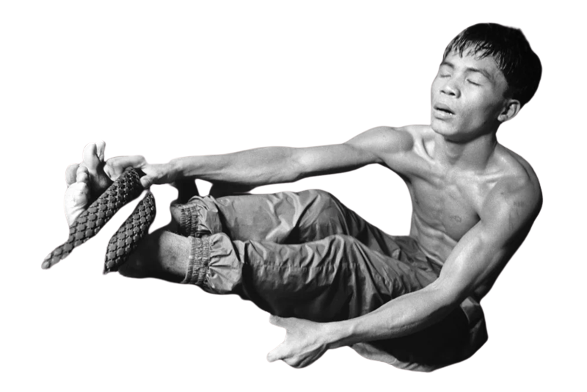
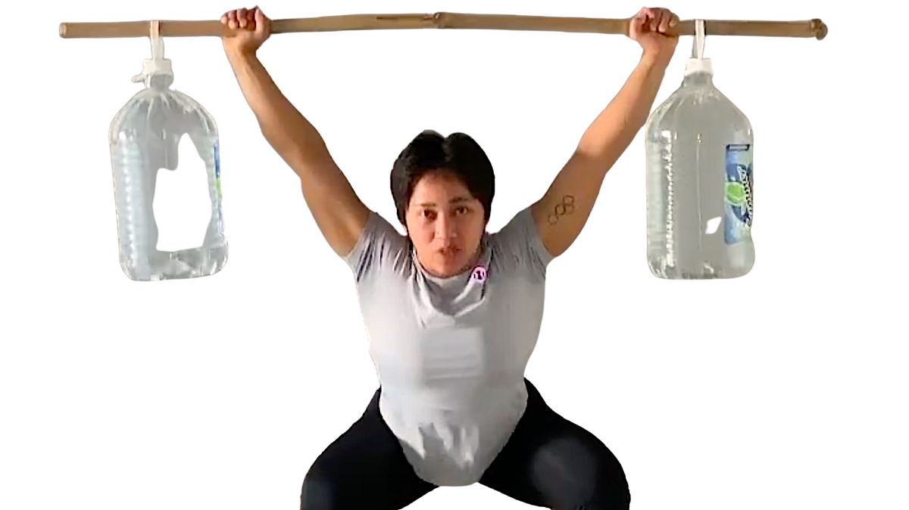
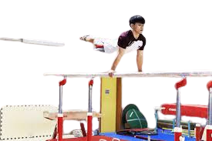
The hard days are the best because that’s where champions are made.

Slide 42
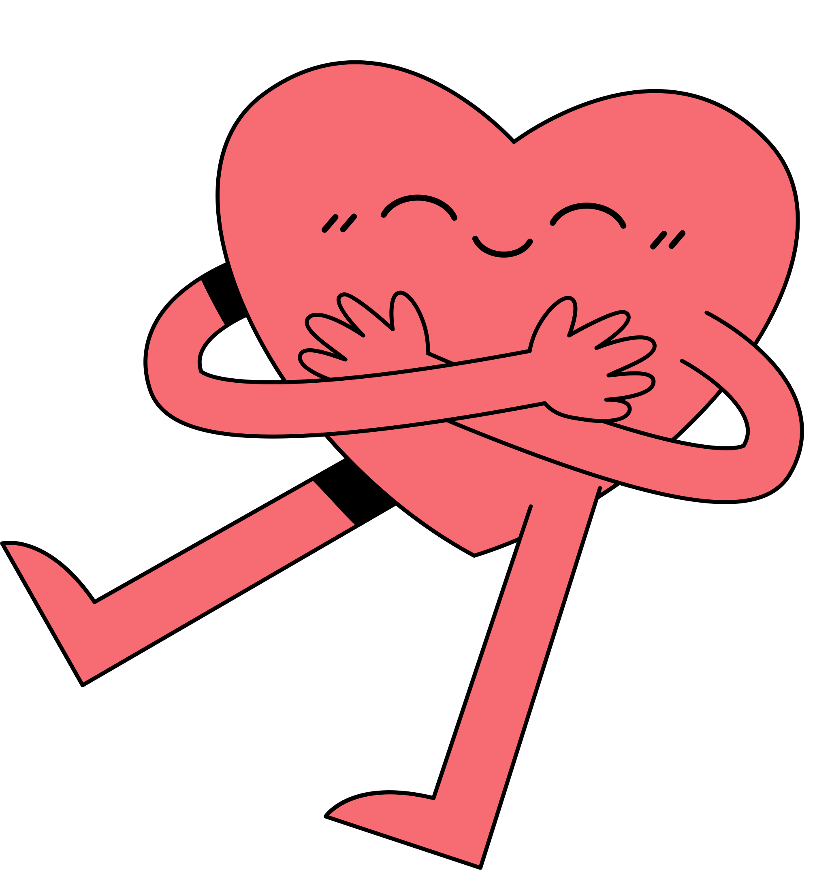

At the moment of decision, pili you:
Saya or Sayang!
Rejoice or Regret?

Slide 43
“Maturity is achieved when a person postpones immediate pleasures for long-term values.”
– Joshua L. Liebman

Slide 44
Quick Game Tayo

Slide 45

3
Service and Spirituality
“Your Imagination is Your Preview of Life’s Coming Attractions”
- Albert Einstein

Slide 46
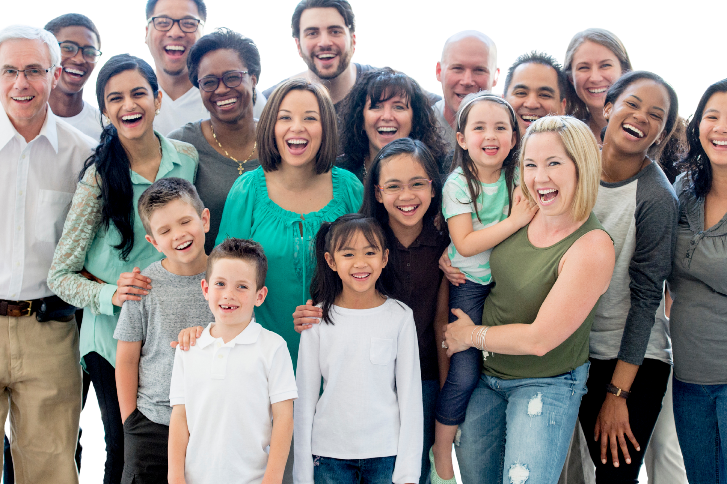
Imagine the best and grandest version of you where you are at your happiest serving your family and the people around you.

Slide 47

Discover your Purpose:
Passion, Potential, Pain, Personality, Peso
= Purity of Mind, Heart, Soul
Passion
Potential
Personality
Your past wasn’t perfect but it was perfect for your purpose.- Bo Sanchez
Pain
Peso

Slide 48
REMEMBER:
Higher level = higher devil

Slide 49
Every action you take is a vote for the person you wish to become. - James Clear, Atomic Habits

Slide 50

Assess yourself on a regular basis
(quarterly, every 6 months, once a year)
Spiritually →
Do I have greater faith this year than last year?
Do I trust in God’s love more?
Physically →
Am I healthier and stronger this year than
last year?
Relationally/
Emotionally →
Are my relationships happier this year than
last year?

Slide 51
Purpose →
Am I growing in my mission and service this year compared to last year?
Mentally →
Am I more knowledgeable this year than last year? Do I think better?
Hobbies/
Fun →
Do I allow myself time to relax and play this year more than last year?
Financially
Am I growing financially or am I growing in debt?
Improve by 1% daily.

Slide 52
Excellence I the next 5 minutes forget the long term.
Make the next five minutes rock!
– Tom Peters

Slide 53
Doing what is right is the most fulfilling thing.

Slide 54
Whatever comes your way,
choose to GROW by doing the right thing
and choose to GLOW by staying close
to God.

Slide 55
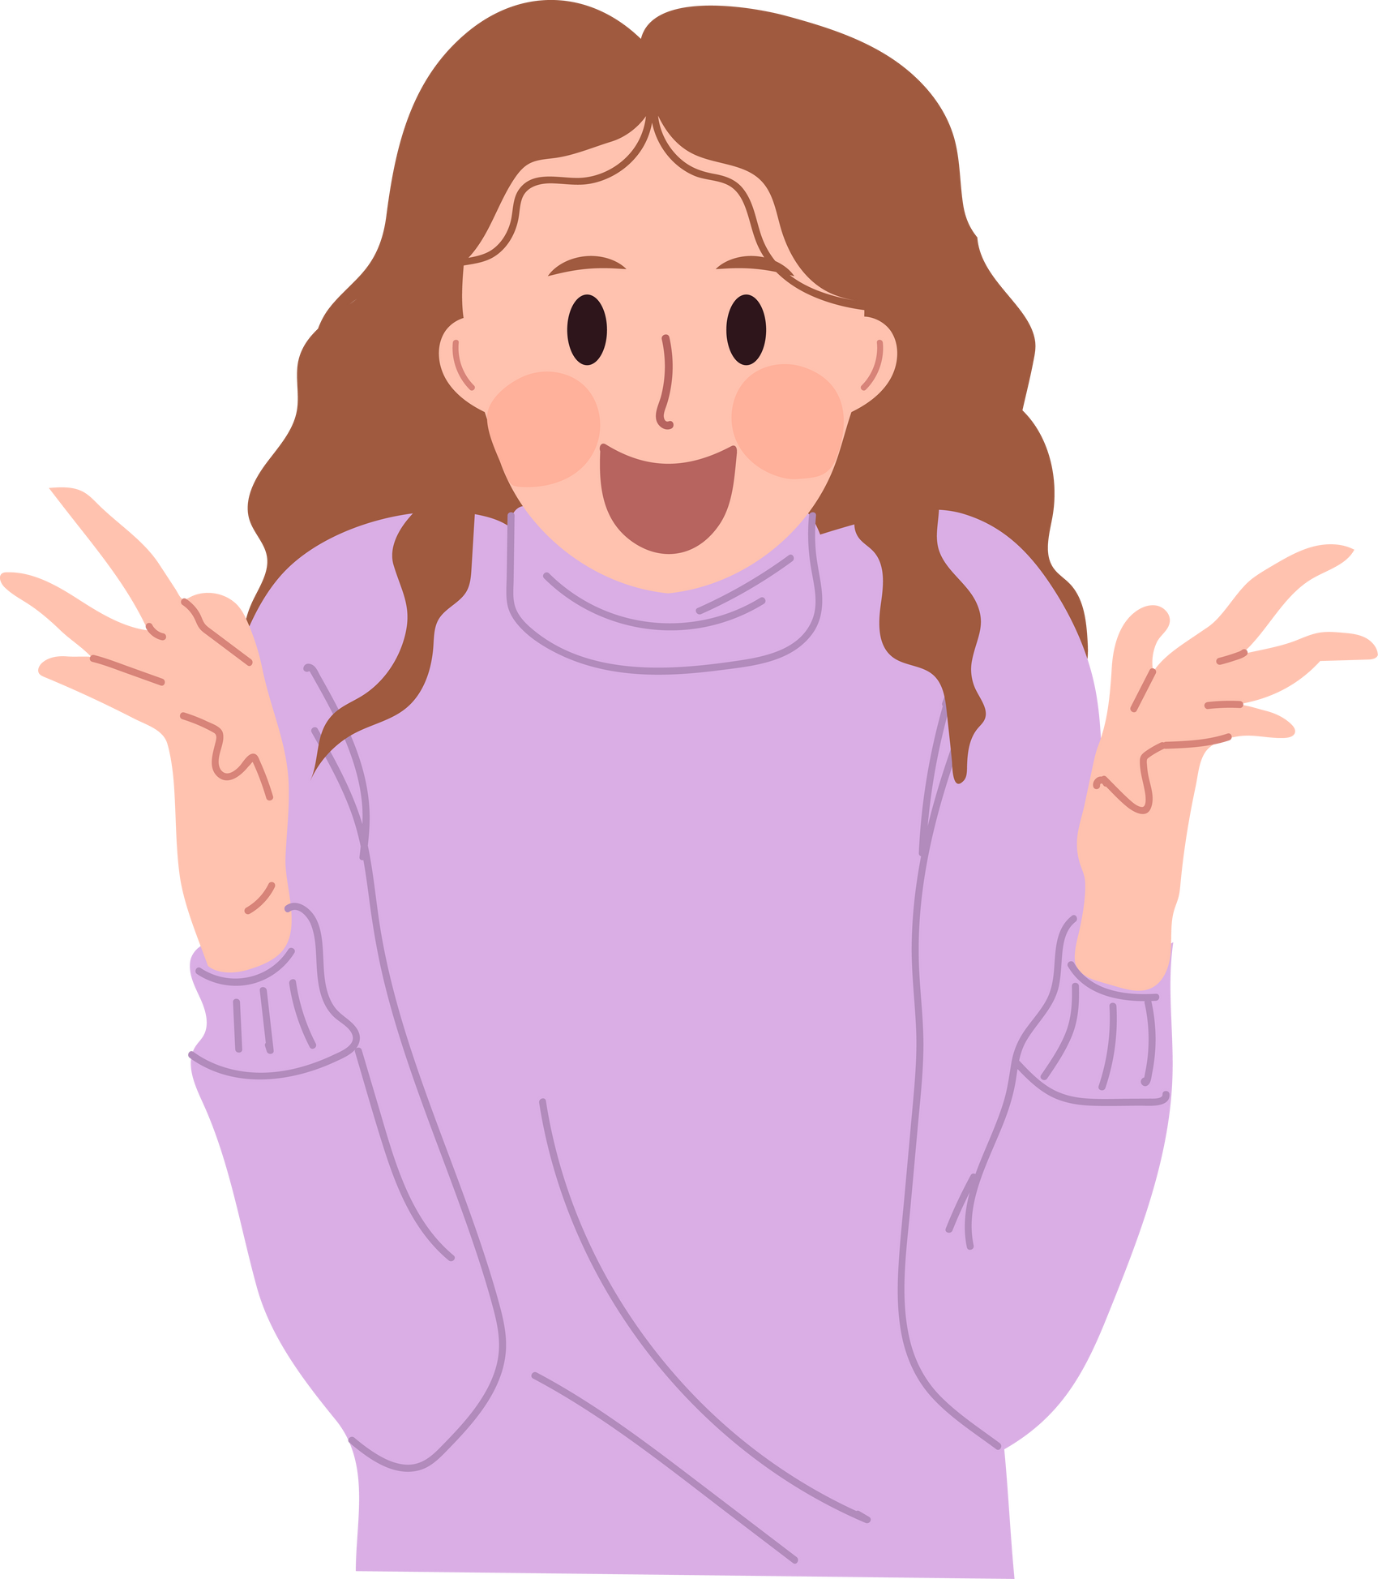
I’m excited for you!

Slide 56


I’m excited for the Philippines!

Slide 57
Quick Game Tayo

Slide 58

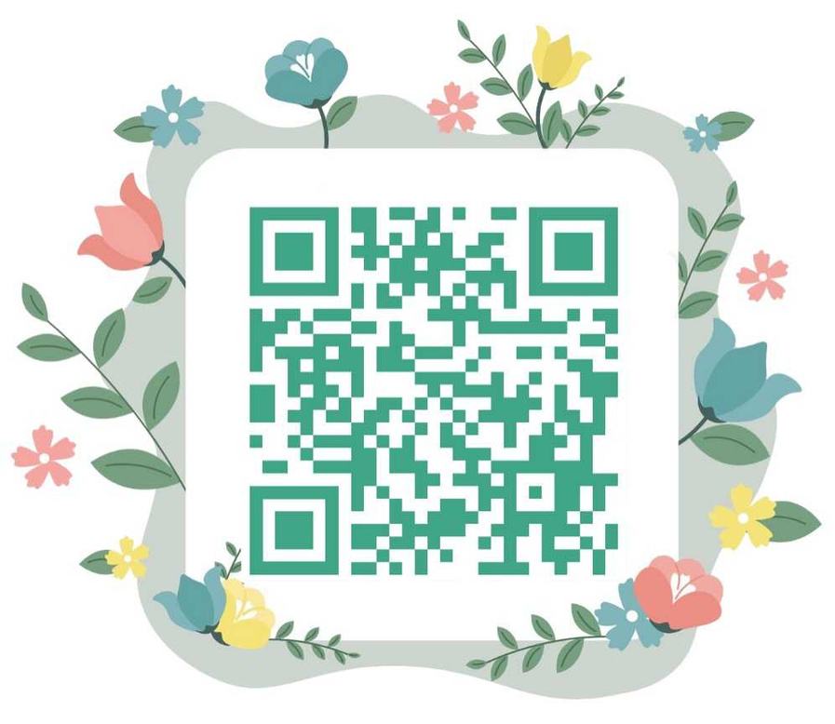
BOOK GIVEAWAY
mariannemencias.com/marupokfree

Slide 59


Slide 60
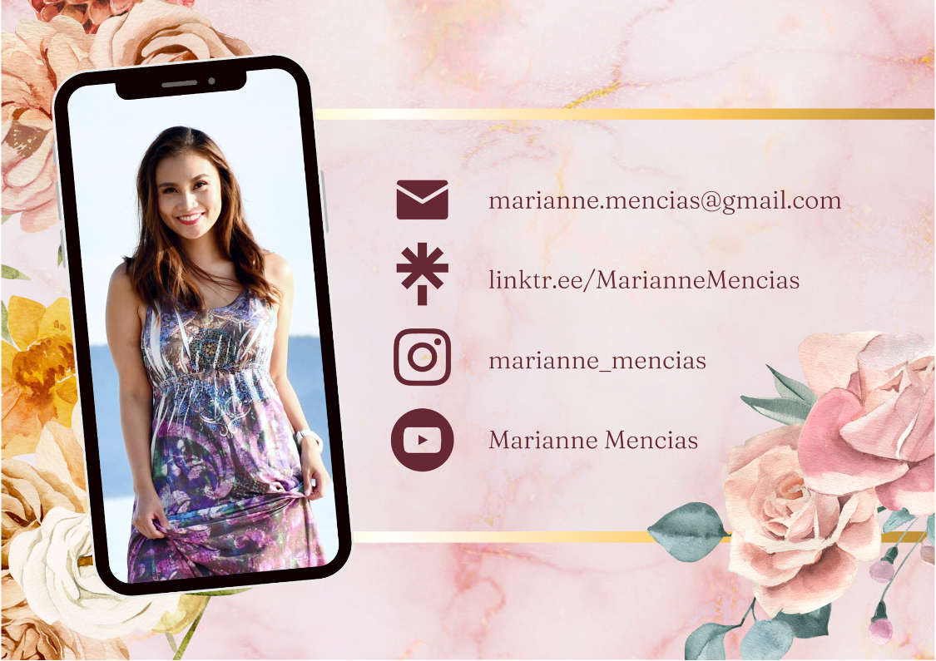

Slide 61
THANK
YOU!

