Slide 1
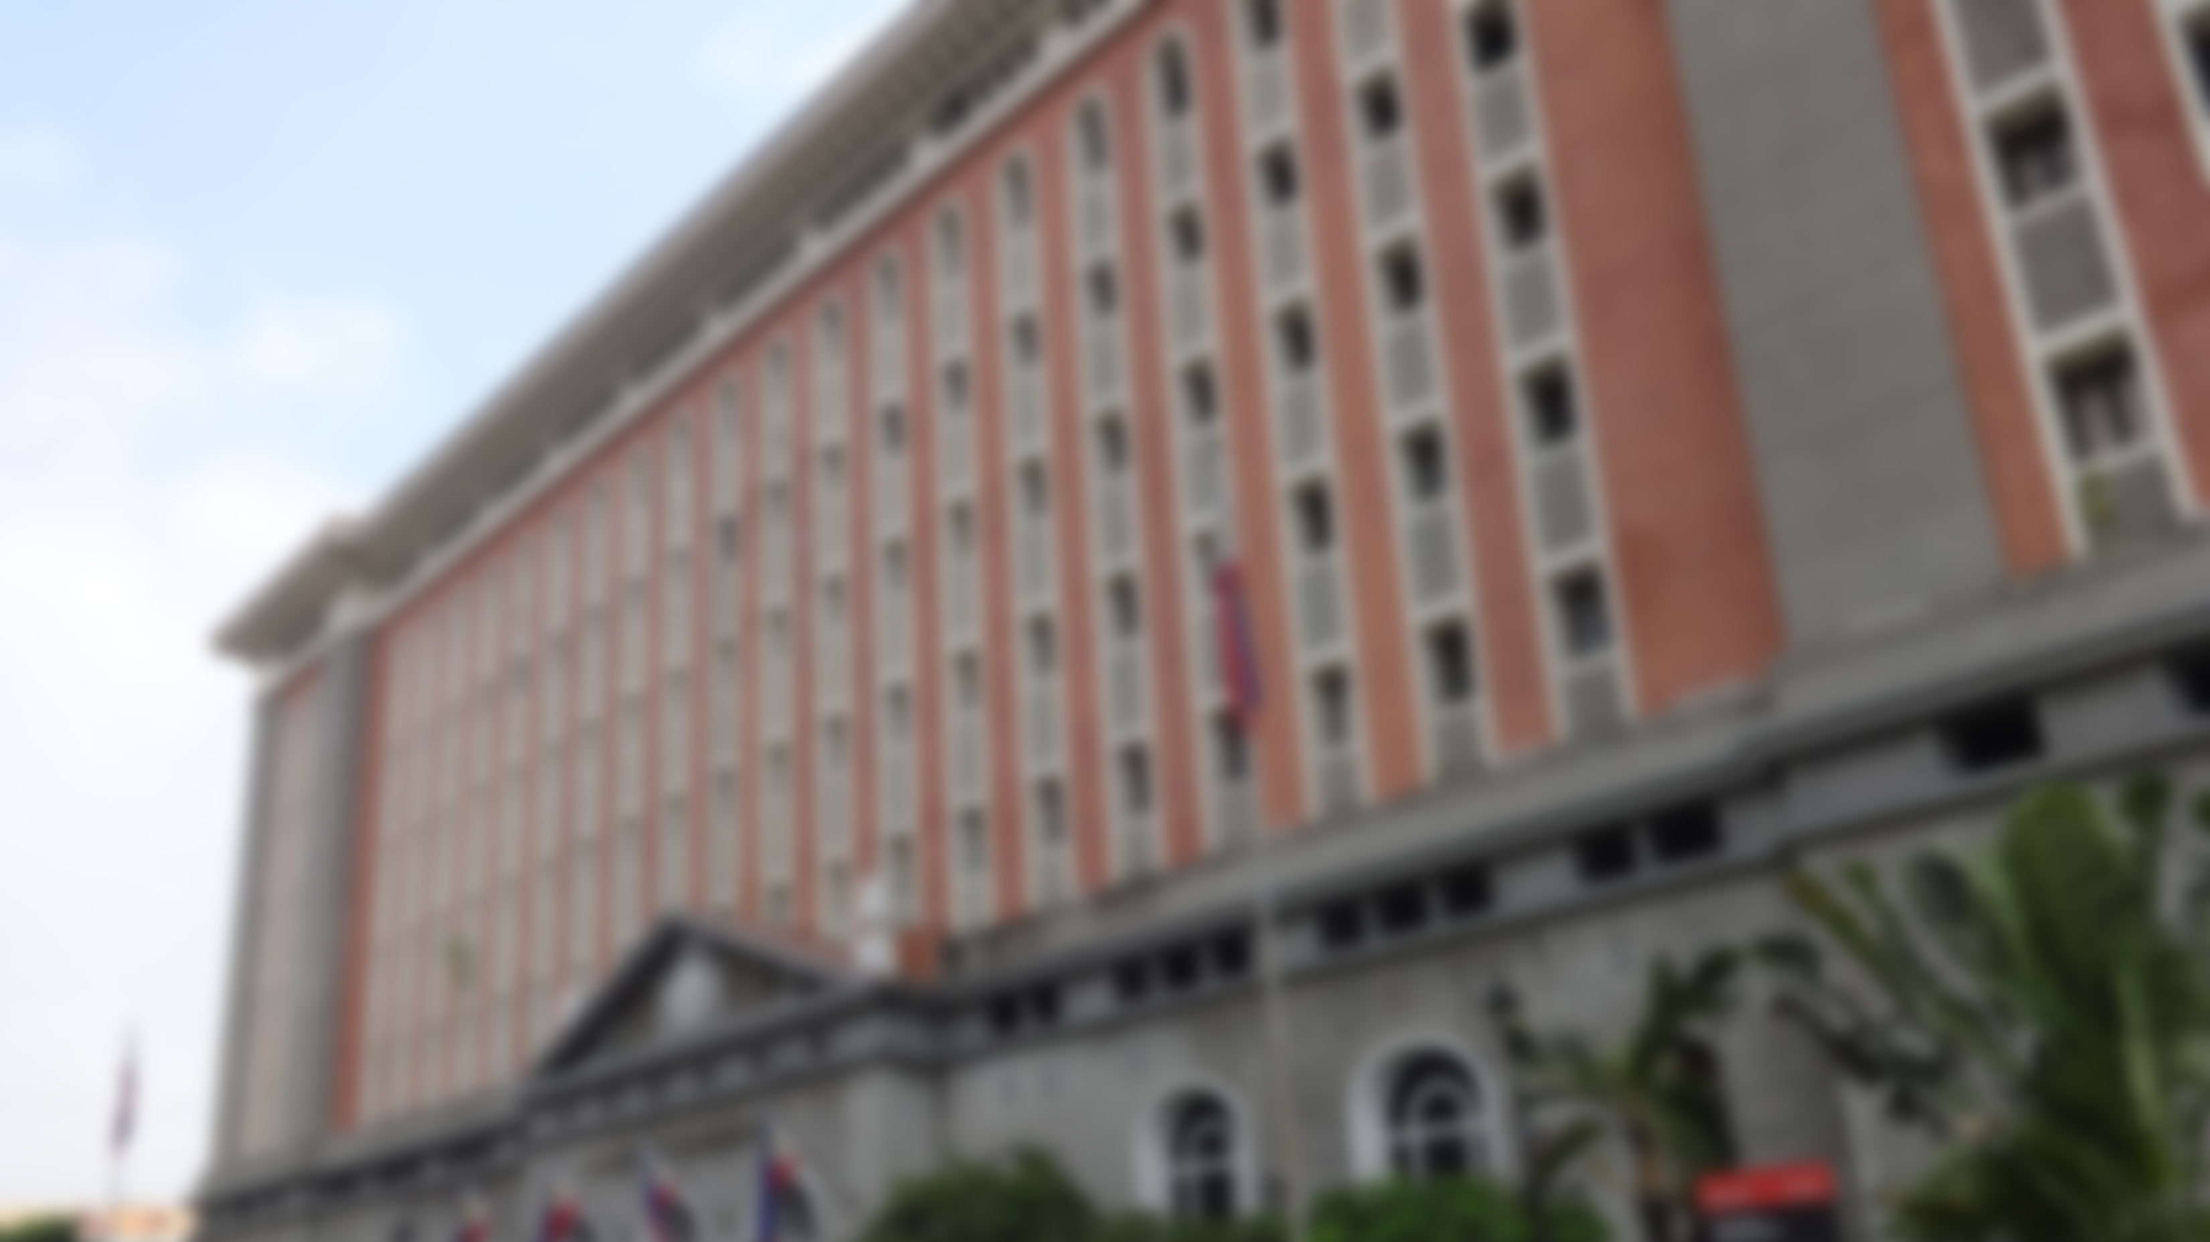


CALENDAR OF ACTIVITIES, RULES AND REGULATIONS ON THE PROHIBITION AGAINST RELEASE, DISBURSEMENT OR EXPENDITURE OF PUBLIC FUNDS

Slide 2
CALENDAR OF ACTIVITES
January 12, 2025, to June 11, 2025:
Election Period, Gun Ban
February 11, 2025, to May 10, 2025:
Campaign Period for candidates for Senator and groups in the Party List elections

Slide 3
CALENDAR OF ACTIVITES
April 13, 2025, to May 12, 2025:
Voting by Overseas Voters
March 28, 2025, to May 10, 2025:
Campaign Period for House of Representatives and Local Officials

Slide 4
CALENDAR OF ACTIVITES
April 28-30, 2025
Voting by local absentee voters
May 11, 2025:
Liquor Ban, Campaigning is prohibited

Slide 5
CALENDAR OF ACTIVITES
May 12, 2025
Election Day
June 11, 2025:
Last day to file SOCE

Slide 6
Holy Week Schedule
NO CAMPAIGNING ON:
  April 17, 2025 – Maundy Thursday
  April 18, 2025 – Good Friday

Slide 7
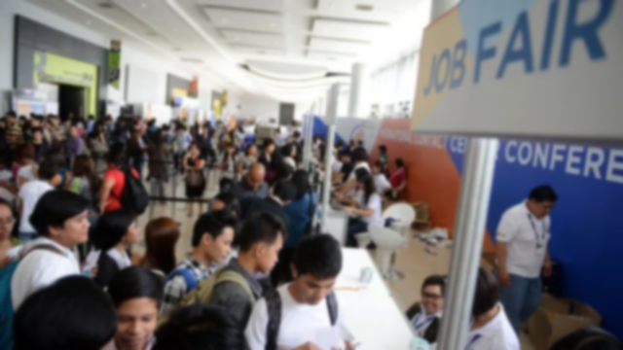
RESOLUTION NO. 11059
IN THE MATTER OF THE PROHIBITION AGAINST APPOINTMENT OR HIRING OF NEW EMPLOYEES, CREATION OF NEW POSITIONS, PROMOTION OR GIVING OF SALARY INCREASES; REMUNERATION OR PRIVILEGES; TRANSFER OR DETAIL OF CIVIL SERVICE EMPLOYEES, ETC.

Slide 8
  January 12, 2025 (Sunday) to June 11, 2025 (Wednesday)
  Ban on transfer or detail of any officer or employee in the civil service, including public school teachers, personnel of the Philippine National Police (PNP) and civilian employees of the Armed Forces of the Philippines (AFP).

Slide 9
  From March 28, 2025 (Friday) until May 11, 2025 (Sunday)
  Ban on Appointment or Hiring of New Employees or Creation of New Position

Slide 10
  March 28, 2025 (Friday) until May 11, 2025 (Sunday).
  Total Ban on Promotion, Salary Increases, Grant of Privileges.
  Any request for authority to promote government official or employee shall be not accepted or given due course by the Commission.

Slide 11

RESOLUTION NO. 11060 as amended
RULES AND REGULATIONS ON THE PROHIBITION AGAINST THE RELEASE, DISBURSEMENT, OR EXPENDITURE OF PUBLIC FUNDS FOR SOCIAL SERVICES AND HOUSING-RELATED PROJECTS, AND ISSUANCE OF TREASURY WARRANTS AND SIMILAR DEVICES

Slide 12

Prohibition on Release of Public Funds:
  For Public Works
  Social services (DSWD or LGU)
  Housing-related
  Relief Goods to victims of calamity

Slide 13
RULE II
PROHIBITIONS AGAINST THE RELEASE DISBURSEMENT OR EXPENDITURE OF PUBLIC FUNDS AND ISSUANCE OF TREASURY WARRANTS AND SIMILAR DEVICES

Slide 14
  Social Welfare and Services Projects; Prohibition, Exemption and Period of Prohibition.
  From March 28, 2025 (Friday) to May 11, 2025 (Sunday),
  From March 28, 2025 (Friday) to May 11, 2025 (Sunday) the release, disbursement, or expenditure of public funds for social welfare and services projects is prohibited, except as authorized by the COMELEC.

Slide 15
Rule II, ComRes No. 11060, as amended by ComRes No. 11113 and ComRes No. 11104
  Ayuda,
  Tulong Panghanapbuhay sa Ating Disadvantaged/Displaced Workers (TUPAD)
  Ayuda para sa Kapos ang Kita Program (AKAP),
  Assistance to Individuals in Cisis Situation (AICS), and
  Pantawid Pamilyang Pilipino Program (4ps).
  From May 02, 2025 (Friday) to May 12, 2025 (Monday), the giving and distribution of Ayuda, TUPAD, AKAP, AICS and 4ps shall be totally prohibited.

Slide 16
  Housing-Related Projects; Prohibition, Exemption and Period of Prohibition.
  From March 28, 2025 (Friday) to May 11, 2025 (Sunday), the release, disbursement, or expenditure of public funds for housing-related projects is prohibited, except as authorized by the COMELEC.

Slide 17
  Treasury Warrants and Similar Devices; Total Prohibition and Period of Prohibition.
  From March 28, 2025 (Friday) to May 11, 2025 (Sunday), the issuance, use, or availment of treasury warrants or any device undertaking future delivery of money, goods or other things of value chargeable against public funds is absolutely prohibited. (sec 5)

Slide 18
RULE III
EXCEPTIONS

Slide 19
Those not needing an exemption
  1. The release, disbursement, expenditure of public funds for relief or other goods to be distributed to the affected individuals and families in case of calamities or disasters does not require exemption from the COMELEC. (Rule III, section 6)

Slide 20
Condition in case of Calamities or Disasters
  The concerned agency/office/LGU shall immediately submit to the Law Department a report containing the following information:
  Type of assistance provided, date and location of the distribution, and the amount of public funds release, disbursed, or expended.
  Certified True Copy of the Executive Order or the Local Sanggunian Resolution declaring a state of calamity in the disaster-stricken area.

Slide 21
Those not needing an exemption
  2. *MOOE are considered normal and routine expenses incurred through day-to-day operations, and are not covered by the prohibition against the release, disbursement, or expenditure of public funds. (sec 7)
  *Maintenance and Other Operating Expenses

Slide 22
Those not needing an exemption
  3. Salaries of Government Personnel (Rule III, Section 8.)

Slide 23
EXCEPTIONS
  4. Release of Public Funds for Projects NOT Covered by the Prohibition under Section 261 (v) of the OEC.
  The release, disbursement or expenditure of public funds for projects/programs/activities (PPAs) which are NOT social service and welfare projects, and housing-related projects is allowed subject to the following conditions:

Slide 24
The Following Conditions:
  a) The PPAs sought to be implemented during the period of forty-five (45) days before the conduct of 2025 NLE and BARMM Parliamentary Elections were established prior to the said period and duly reported to the Commission on Audit (COA) pursuant to Item 2.1 of its Circular No. 2013-004 dated 30 January 2013;

Slide 25
The Following Conditions:
  b) The public awareness and information dissemination activities pertaining to these PPAs must conform to the guidelines provided under the said COA Circular;

Slide 26
The Following Conditions:
  c) In no instance shall the implementation of PPAs be used as an opportunity by any candidate, his or her spouse, family member within the second civil degree of affinity or consanguinity to further their candidacy through their personal appearance in such events, the posting, exhibition or distribution of any form of election propaganda, or any material containing their names, logos, initials, mottos, slogans, images, and other forms of representation attributable to them;

Slide 27
The Following Conditions:
  d) Support for or endorsement of candidates shall not be made as a condition for the entitlement of the benefits from the PPAs; and

Slide 28
The Following Conditions:
  e) Candidates, their spouses, and members of their family within the second civil degree of affinity or consanguinity are strictly prohibited from participating, directly or indirectly, in the distribution of cash, goods or merchandise for scholarships, assistance for burial, healthcare, calamity and other similar programs. A violation of this condition shall subject the candidates or their representatives to liability under Section 261(o) of the OEC.

Slide 29
RESOLUTION NO. 11078
RULES AND REGULATIONS ON THE PROHIBITION AGAINST THE RELEASE, DISBURSEMENT, OR EXPENDITURE OF PUBLIC FUNDS, CONSTRUCTION OF PUBLIC WORKS, DELIVERY OF MATERIALS FOR PUBLIC WORKS, ISSUANCE OF TREASURY WARRANTS AND SIMILAR DEVICES

Slide 30
RULE I
PUBLIC WORKS BAN

Slide 31
PUBLIC WORKS BAN
  Public works defined
  Whenever used in this Resolution, "public works" refer generally to "infrastructure projects" or any building or structure on land or to structures built by the Government for public use and paid for by public funds. It encompasses fixed works constructed for public use or enjoyment financed and owned by the government.

Slide 32
PUBLIC WORKS DEFINED
  It includes the construction, improvement, rehabilitation, demolition, repair, restoration, or maintenance of roads and bridges, railways, airports, seaports, communication facilities, civil works components of information technology projects, irrigation, flood control and drainage, water supply, sanitation, sewerage and solid waste management systems, shore protection, energy/power and electrification facilities, national buildings, school buildings, hospital buildings, and other related construction projects of the government. (sec 1)

Slide 33
PUBLIC WORKS BAN
  Prohibition on Release, Disbursement or Expenditure of Public Funds.
  Effective March 28, 2025 (Friday) until May 11, 2025 (Sunday), no public official or employee, and those of government-owned and controlled corporations and their subsidiaries shall release, disburse, or expend any public funds for: Any and all kinds of public works

Slide 34
Except the following:
  a) Maintenance of existing and/or completed public works projects: Provided, that not more than the average number of laborers or employees already employed therein during the six (6)-month period immediately prior to March 28, 2025, shall be permitted to work during such time: Provided, further, that no additional laborers shall be employed for maintenance work starting March 28, 2025, until May 11, 2025;

Slide 35
  b) Work undertaken by contract through public bidding held, or by negotiated contract awarded, before March 28, 2025: Provided, that for the purpose of this Section, work under the so-called “takay” or “pakyaw” system shall not be considered as work by contract;

Slide 36
  c) Payment for the usual cost of preparation for working drawings, specifications, bills of materials, estimates, and other procedures preparatory to actual construction including the purchase of materials and equipment, and all incidental expenses for wages of watchmen and other laborers employed for such work in the central office and field storehouses before March 28, 2025: Provided, that the number of such laborers shall not be increased over the number hired when the project or projects were commenced; and

Slide 37
  d) Emergency work necessitated by the occurrence of a public calamity, but such work shall be limited to the restoration of the damaged facility.

Slide 38
  No payment shall be made within five (5) days before the date of election to laborers who have rendered services in projects or works except those falling under sub-paragraphs (a), (b), (c), and (d), of this Section.

Slide 39
  The prohibition shall not apply to on-going public works projects commenced before the campaign period or similar projects under foreign agreements. For purposes of this provision, it shall be the duty of the government officials or agencies concerned to report to the Commission the list of all such projects being undertaken by them as provided for under Section 2 of this Resolution. (sec 2)

Slide 40
PUBLIC WORKS BAN
  Prohibition Against Construction of Public Works, Delivery of Materials for Public Works and Issuance of Treasury Warrants and Similar Devices.
  Effective March 28, 2025 until May 11, 2025, no person shall:

Slide 41
  No Person Shall:
a) Undertake the construction of any public works, except for projects or works exempted in the preceding Section; or
b) Issue, use, or avail of treasury warrants or any device undertaking future delivery of money, goods, or other things of value chargeable against public funds.

Slide 42
RULE II
NOT COVERED BY THE BAN

Slide 43
NOT COVERED BY THE BAN
  Immediate payment of laborers required (Rule II, Section 1);
  Public-Private Partnership and Build-Operate-Transfer Projects (Rule II, Section 2) ;
  Irrigation Projects (Rule II, Section 3);
  MOOE (Rule II, Section 4);
  Salaries of Government Personnel (Rule II, Section 5) and;

Slide 44
NOT COVERED BY THE BAN
  6. Projects and programs entailing the use of other state/public funds not covered under Section 261 (v) of the OEC (Rule II, Section 6).
  The release, disbursement or expenditures of other state funds are allowed subject to the following conditions:

Slide 45
The Following Conditions:
  (a) The projects/programs/activities ("PPAs") sought to be implemented during the prohibited period of March 28, 2025 to May 11, 2025 were established before the said period and duly reported to the Commission on Audit pursuant to Item 2.1 of its Circular No. 2013-004 dated 30 January 2013;

Slide 46
The Following Conditions:
  (b) The public awareness and information dissemination activities pertaining to these PPAs must conform to the guidelines provided under the said COA Circular.

Slide 47
The Following Conditions:
  (c) In no instance shall the implementation of PPAs be used as an opportunity by any candidate, his or her spouse, family member within the second civil degree of affinity or consanguinity, political parties, party-list organizations and their nominees to further their candidacy through their personal appearance in such events, the posting, exhibition or distribution of any form of election propaganda, or any material containing their names, logos, initials, mottos, slogans, images, and other forms of representation attributable to them.

Slide 48
The Following Conditions:
  (d) Support for or endorsement of candidates,party-list organizations and political parties shall not be made as a condition for the entitlement of the benefits from the PPAs.

Slide 49
The Following Conditions:
  (e) Should the PPAs involve distribution of cash, goods or merchandise for scholarships, assistance for burial, healthcare, calamity and other similar programs, candidates, party-list nominees, their spouses, and members of their family within the second civil degree of affinity or consanguinity are strictly prohibited from participating, directly or indirectly, in the distribution thereof.

Slide 50
NOT COVERED BY THE BAN
  For excepted expenditures under Sections 4 (MOOE) and 5 (Salaries of Government Personnel) of this Rule, the concerned government agency need not request for the certificate of exception.

Slide 51
RULE III – Certificate of Exception
  Section 1. Submission to the Commission of the certified list of authorized public works projects to the Political Finance and Affairs Department (PFAD) of the Commission.
  All on-going public work projects commenced before March 28, 2025;
  All on-going public work projects under foreign agreements commenced before March 28, 2025;
  All public works undertaken by contract through public bidding held, or by negotiated contract awarded, before March 28, 2025.

Slide 52
RULE III – Certificate of Exception
  Section 2. Submission online and the use of prescribed form. – All submission for the issuance of the Certificate of Exception must be filed online on or before March 28, 2025 in the COMELEC website using the Public Works Ban Link.
  Section 3. Documentary requirements for issuance of Certificate of Exception.

Slide 53
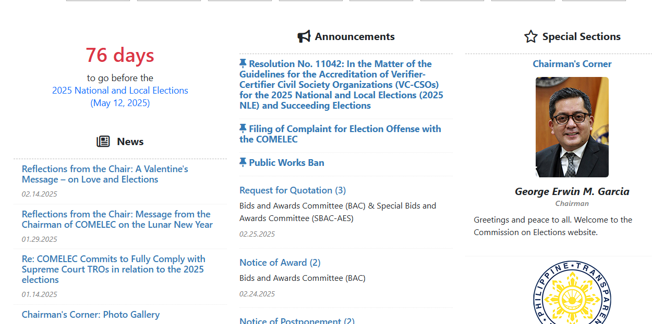

Slide 54
RESOLUTION NO. 11104
IN THE MATTER OF EXPANDING THE POWERS AND FUNCTIONS OF THE COMMITTEE ON KONTRA BIGAY AND TO INTEGRATE GUIDELINES AGAINST ABUSE OF STATE RESOURCES IN THE CONDUCT OF ELECTIONS

Slide 55
ARTICLE III
ACTS CONSTITUTING ABUSE OF STATE RESOURCES

Slide 56
ACTS CONSTITUTING ABUSE OF STATE RESOURCES
Acts Constituting Acts Abuse of State Resources. - ASR pertains to the misuse of government resources/ whether material, human, coercive, regulatory, budgetary, media-related, or legislative, for electoral advantage, committed as follows:

Slide 57
ARTICLE III – ACTS CONSTITUTING ABUSE OF STATE RESOURCES
A. Intervention of public officers and employees;
B. Undue influence;
C. Use of public funds, money deposited in trust, equipment, facilities owned or controlled by the government for an election campaign;
D. Release, disbursement or expenditure of public funds.
E. Construction of Public Works, Delivery of materials for Public Works and issuance of treasury warrants and similar devices.

Slide 58
ACTS CONSTITUTING ABUSE OF STATE RESOURCES
Presumed ASR - The following conduct shall be presumed acts constituting ASR in elections, committed by the incumbent elected public official and/or government employee who exercises control or administrative directly or indirectly, over government resources, for his or her election benefit/gain or for the interest of his or her political party or relative/ s who are candidates for elective office:

Slide 59
PRESUMED ACTS CONSTITUTING ASR
a. The storage or transport of campaign materials, or any paraphernalia, including the name, visage, appearance, logo, signature or other analogous image of any candidate on government vehicles, including motor vehicles used as patrol cars or any mobile asset bearing government license plates, unless made pursuant to Operation "Baklas" of the Commission;

Slide 60
PRESUMED ACTS CONSTITUTING ASR
b. The storage of foods and beverages intended for the supporters of certain candidates, as well as tarpaulins, vests, posters, sample ballots, or any paraphernalia that tends to promote the election of a candidate, in barangay halls, covered courts or any government facility or property of the government.

Slide 61
PRESUMED ACTS CONSTITUTING ASR
c. The display of campaign materials in covered courts, barangay halls unless designated as common poster area, or any government facility or property, including motor vehicles such as patrol cars, ambulances and other vehicles bearing government license plates;

Slide 62
PRESUMED ACTS CONSTITUTING ASR
d. The distribution or delivery of assistance and legitimate social welfare benefits and programs of the government such as TUPAD, AKAP, AICS and 4Ps, with displayed campaign materials, paraphernalia, or those made in the presence and participation of the candidate or his or her spouse or member of his family within the second civil degree of affinity or consanguinity;

Slide 63
PRESUMED ACTS CONSTITUTING ASR
e. The use of government funded media platforms, or then official page/s of government instrumentalities that consistently feature the face, image, appearance, logo, signature or other analogous image of any public official;

Slide 64
PRESUMED ACTS CONSTITUTING ASR
f. The use of government funded media platforms, or the official page/s of government instrumentalities to live stream campaign activities of the incumbent, his/her political party, or candidates;

Slide 65
PRESUMED ACTS CONSTITUTING ASR
g. The use of programs, activities, projects, which are government funded as a platform to display the corresponding signage, name/ visage, appearance, logo, signature or other analogous image or promote the candidacy of any public official, whether elected or appointed;

Slide 66
PRESUMED ACTS CONSTITUTING ASR
g. The use of programs, activities, projects, which are government funded as a platform to display the corresponding signage, name/ visage, appearance, logo, signature or other analogous image or promote the candidacy of any public official, whether elected or appointed;

Slide 67
PRESUMED ACTS CONSTITUTING ASR
h. The sudden and unjustified revocation during the campaign period, of existing scholarships and other government grants to qualified beneficiaries, or the undue refusal to include qualified individuals in legitimate programs of the government such as but not limited to scholarships,4Ps;

Slide 68
PRESUMED ACTS CONSTITUTING ASR
i. The sudden influx of hiring of Job Order and Contract of Services workers and their conduct of partisan political activities by campaigning for or against a candidate, during official working hours;

Slide 69
PRESUMED ACTS CONSTITUTING ASR
j. Such other analogous circumstances.
These presumptions shall apply to the spouse and relative/s within the second civil degree of consanguinity or affinity of any incumbent candidate.

Slide 70
END OF PRESENTATION
THANK YOU!

